Slide 1
Chapter 18 Workers

Slide 2
Learning Outcomes
Identify the factors affecting an individual’s choice of occupation (wage and non-wage factors)
Describe the likely changes in earnings over time for an individual
Describe the differences in earnings between different groups of workers

Slide 3
How are workers paid??
Payment Methods
Fringe Benefits
Time Based Systems
Results Based Systems
Salaries
Wages
Overtime
Piece Rates
Commission
Bonuses
Performance Related Pay
Profit Sharing
In what sorts of occupations would these typically be used?
What benefits or problems can you think of for each of these methods of remuneration?

Slide 4

Wage Factors
Most people will supply their labour to firms to earn an income.
pay wages to workers to supply their labour to produce goods and services.
Paid employment therefore provides people with money to buy the goods and services they need and want and cannot produce themselves.

Slide 5
What are fringe benefits?
Any other perks of the job which do not involve direct payment of money to the employee
What kind of Fringe Benefits do companies offer?

Slide 6





Fringe Benefits
Any other examples you are aware of?
Ask your parents if they get any fringe benefits with their job

Slide 7


Why choose this job?
WAGE FACTORS
+
NON-WAGE FACTORS

Slide 8
You and your job choice
Think about a job that you fancy doing when you are older (don’t worry, no-one will hold you to it!!)
Why have you picked this particular career?
Lets share to find out why you have chosen your future careers…..
Write a list of the non-wage factors that influence a worker’s decision over what job to do…….

Slide 9
OCCUPATIONS AND EARNINGS
Choosing an Occupation
WAGE REASONS
People work for a salary as a means of survival.
Hours of work
Non-Wage Factors
Qualification Required
Holiday
Entitlement
Job Security
Pensions
Flexible Working Arrangement
Type of Work
Size of firm
Job satisfaction
Fringe Benefit
Working Enviroment/Conditions
Promotion Prospects/Career prospects
Distance from home/Location

Slide 10
Limiting factors
Most people obviously like well paid jobs. (fringe benefits ect)
In practice peoples occupation are limited number of factors
Qualifications (occupational mobility)
Skills
Experience
Places they live (geographical mobility)
When people have to choose, give well paid job for job satisfication (less paying) then opportunity cost arises.
The opportunity cost of working for job more satisifaction is less pay.

Slide 11
The labour Market
1. The demand for labour is derived demand . Where there is an increase demand for goods and services, then you will see and increase in demand for labour.
2. So long as the cost of 1 extra labour is lower than the revenue gained from using 1 more labour, the producer will continue to employ more labour until the additional cost = the additional revenue.
3. Producers use labour . So the demand for labour is from producers.
4. Consumers provide labour - So the supply of labour comes from consumers.
(This is the opposite of your normal demand and supply where the demand curve represents consumers and supply curve represents producers)

Slide 12

Questions…..
In the labour market…
1. Who are the suppliers?
2. Who are the buyers?
3. What does the equilibrium price represent?
4. What does the equilibrium quantity represent

Slide 13
OCCUPATIONS AND EARNINGS
What Determines Market Equilibrium Wage Rate?
Ans: Market demand and supply for labour.
The labour Market
Wage Rate
S
E
W0
D
Units of Labour/hour

Slide 14
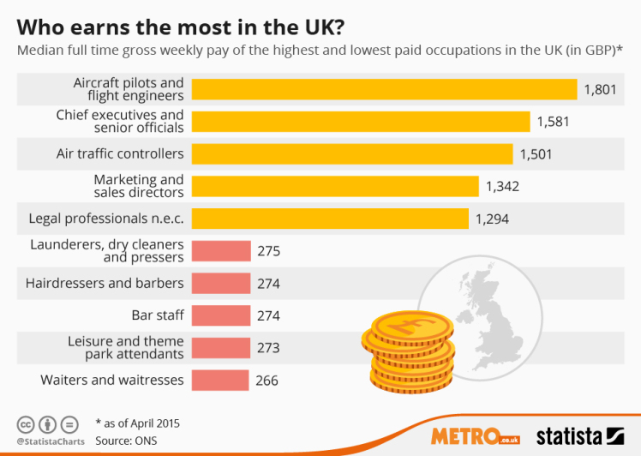

Slide 15
Wage differentials (difference in earnings)
There is a wide gulf in pay and earnings rates between different occupations in the most countries labour market.
Demand & Supply
Write down factors of elasticity for the 2 types of work?
Demand side
If labour has high MRP (price out put can be sold) & demand for product is high and inelastic higher wages more likely
High demand for final product factor for sports & other entertainment stars
Supply side
If they have high level skills, expertise, qualifications, long training periods, geographical & occupational mobility low
Wage Rate MRP
Surgeon Cleaner
Demand for labour | Supply of labour | Type of salary | Occupation | MRP (output sold)
High | Inelastic | High salary | Surgeon | High
Low | Elastic | Low salary | Cleaners | Low
S
WS
WC
S
D
D
QS QC

Slide 16
Elasticity of supply of labour
Responsiveness of quantity of labour supplied to change in real wage rate
Factors influencing the elasticity of supply of labour
Occupational mobility of labour
Jobs that require specific skills and higher level qualifications will find it more difficult attract workers when real wages rises. Eg doctors
Length of training
There are few workers with relevant skills.
Elasticity of labour supply tends be lower for skilled jobs than for unskilled jobs
Geographical mobility
Looks the ability to move to different areas for a job
Such as family ties and schooling
Cost of housing
Emigration EU
Other factors
High levels of unemployment in the economy large pool of labour reverse if full employment
Time period ( people can be trained to be doctors)
Workers from other industries recruited particularly if required are unskilled

Slide 17

Why Do Wages Differ For Different Occupation? (wage differentials)
Different ability (footballers & singers) and qualification (Dr) .
Difficult working conditions such has dangerous/shiftwork. (compensating differentials)
Jobs satisfaction. (Certain jobs are more satisfying than others and as such there is a large pool of supply of labour which causes the wage for them to be lower)
4. Lack of information about jobs. (Jobs paying more elsewhere restrict supply)
5. Labour immobility – needing to pay more to motivate labour to travel to places further away where job is more readily available.

Slide 18


Slide 19
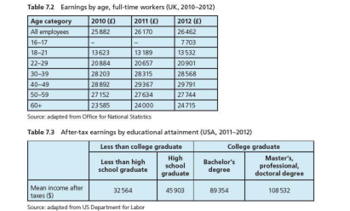

Slide 20
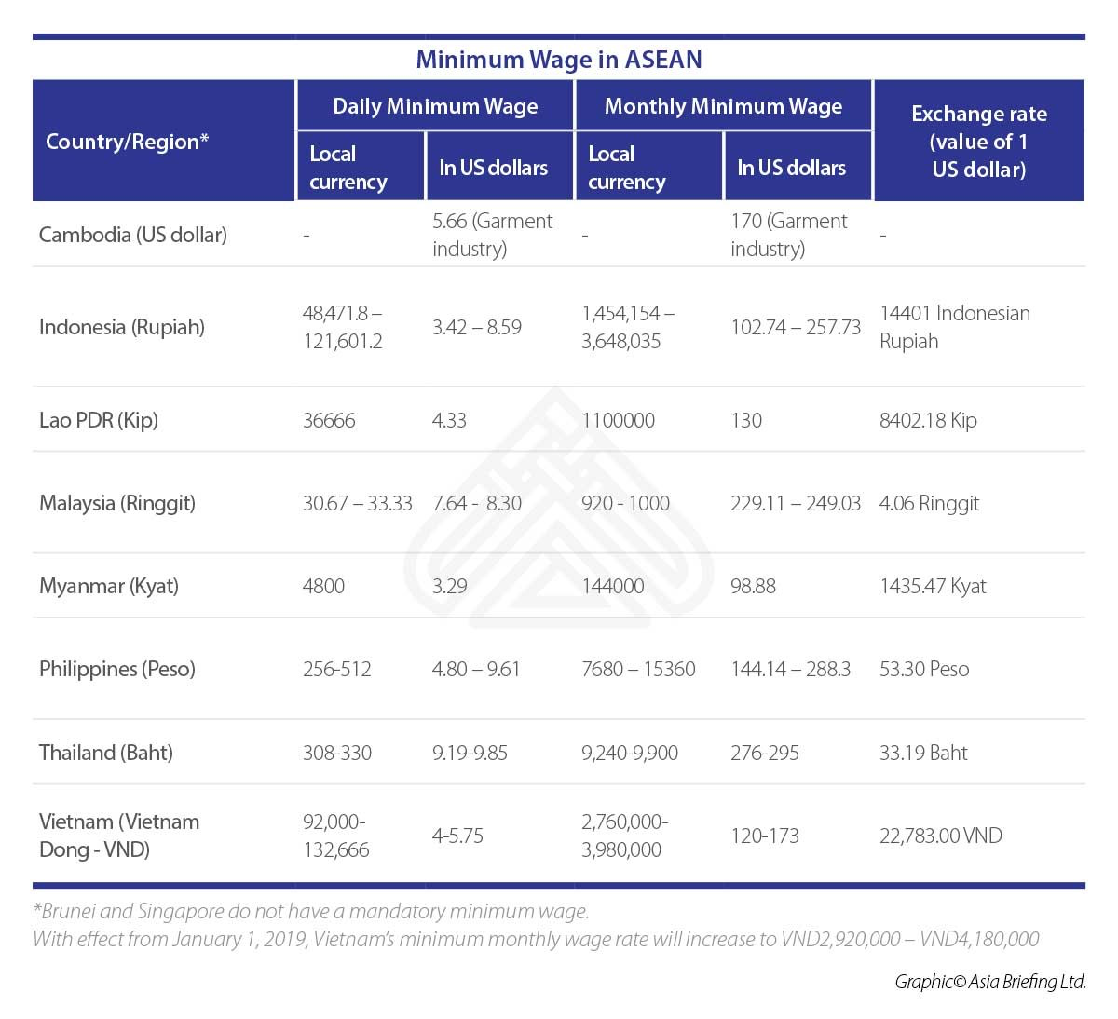
Australia
The new hourly minimum rate of $18.93 will take effect from July 1.

Slide 21
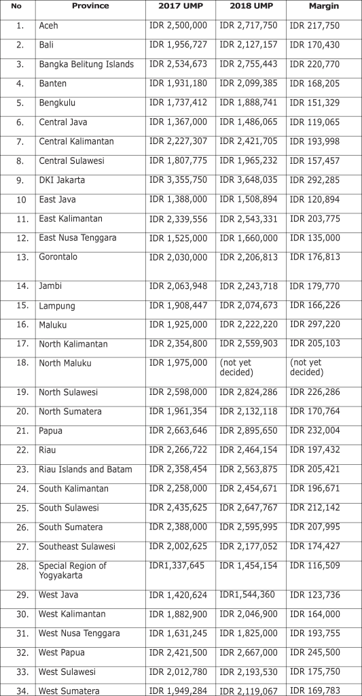

Slide 22
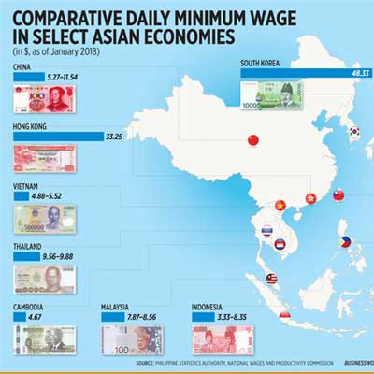

Slide 23
Minimum wage legislation
1. Equilibrium employment 0-Qe
2. Govn’t place minimum rate at Wm
3. Will 🡹 cost firm
4. 🡻 Demand for employment to Qd
5. Causing people to be unemployed from Qd to Qe
6. High wages more people willing to work Qs
Wage rate
wage
rate
7. Demand is at Qd thus excess of workers at Qd -Qs
S labour (workers)
excess supply of labour
Wm
↑unemployment
labour market with no government intervention
W_{e}
D labour
(firms)
↓ employment
Q_{d}
Q_{e}
Q _{s}
Q
O
Quantity of labour

Slide 24
Advantage | Disadvantage
Workers receive a fair wage for an hour's work and are not exploited by employers. | Blurs wage differential between lowest skilled workers & others Workers who earn more than the minimum wage may request a higher wage rate to maintain the wage differential. E.g. when cleaners in an office receive a pay rise (NMW) other office staff may ask for a wage increase to maintain the difference between cleaners. This causes cost of labour to firm even larger
Unemployed people may have an incentive to work as the wage may be more attractive than relying on welfare payments | Results in increase unemployment due to higher wage rate (demand for labour will ⬇) results in jobs moving to other areas or countries which allow lower-cost labour Use of capital instead of labour
Low-income earners may have more money to spend and this may increase consumption in the economy, thus easing any fears that higher wages{costs of production} might cause unemployment

Slide 25
Pros
Most supporters of the minimum wage are worker advocates.
First, workers who can cover the cost of living have better morale. They are more productive if they have a decent standard of living.
Second, it reduces income inequality while providing an incentive to work. The incentive makes it better for society than welfare or a universal basic income.
Third, a minimum wage spurs economic growth. It gives workers more money to spend. This increases demand and business revenue.
Fourth, workers who have more time and money can then invest in their education. This further increases their productivity. It improves the attractiveness of the country's labor pool. A more educated workforce increases innovation and the number of small businesses.
Fifth, minimum wage laws benefit individual businesses. Workers are less likely to leave to find a higher-paying job. This reduces turnover and expensive retraining costs.

Slide 26
Other labour market interventions
Governments may intervene in labour markets to:
protect the rights of employees and employers, e.g. health and safety regulations, minimum rest periods
outlaw and regulate restrictive practices that may be used by powerful trade unions and major employers, e.g. outlawing strikes by trade unions
reduce unemployment, e.g. government training schemes, subsidies to encourage firms to locate in areas of high unemployment
outlaw unfair discrimination, e.g. equal pay laws

Slide 27
How Much Bargaining Power Do Workers Have?
Bargaining Power is the ability for firms or workers to get what they want.
An example of collective bargaining power is related to the power of trades unions.
If a part-time worker works for a firm, they will have very low bargaining power.
Doctors & Lawyer belong to professional organizations represent their interests
Bargaining power
Easily replaced
How disruptive a strike will be to the community eg public transport

Slide 28


Public opinion
Public opinion jobs which have long study & training rewarded
Doctors & Nurses highly regarded
Public opinion can effect wage claims eg fire fighters thus police as well
Wage rates table for different types jobs
Public pressure for higher pay for nurses thus government bow to public pressure

Slide 29
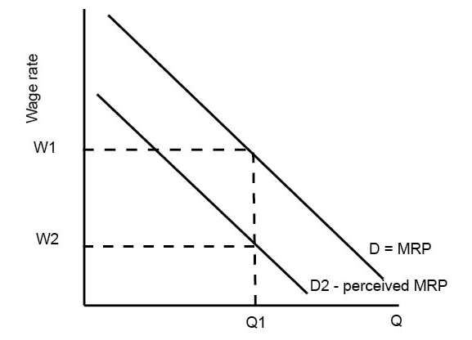
Another potential source of wage inequality is discrimination, e.g. women gaining lower hourly pay due to the
perceived difference in ability.
In theory, wage discrimination is outlawed, though it may manifest itself in other forms, such
as some types of workers getting few opportunities to be promoted to higher pay scales.
There are more women in pan-time work than men, so their earnings are lower on average.
Women rake career breaks to have children and therefore miss out on promotional opportunities.
Women may accept low-paid and part-time jobs, as hours are flexible and can fit in with childcare arrangements.
women may face discrimination at work.
Less likely to belong to trade union
D=MRP shows marginal revenue product of workers. However, because of discrimination and employers preferences to avoid certain groups of workers, the ‘perceived’ MPR of that group is lower than it actually is. This group will not be employed at W1 and will have to accept lower wages.

Slide 30
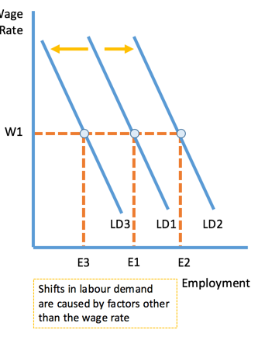
Why earning of occupation change over time
Change in earnings occurs due to change in demand for labour and change in supply of labour.
If demand for labour increases the earnings increases.
If supply of labour decreases the earnings increases.
Why firms change their demand for labour
Changes in consumer demand for goods and services. Eg More workers ( Increase/Growth of AD )
Changes in the productivity of labour. (higher productivity means less labour is required)
Change in price of goods & services
Changes in the price and productivity of capital.(capital vs labour intensive production, depends on which is cheaper and more productive) (short-term costly long term benefit)
Changes in non-wage employment costs.(eg, unemployment insurance)
Change in government subsidies (for employing workers)
The amount of output and the price good & services can be sold for (higher price more labour)

Slide 31
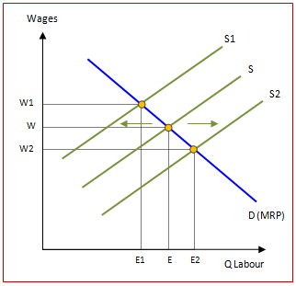
Change in Labour Supply is due to the following:
Changes in the net advantages of an occupation. (eg. Number off days, time off for children/parent care) if these decrease thus less workers offer supply thus shifting to S1
2.Changes in the provision and quality of education and training.
3.Demographic changes.
(eg. Inward migration an increase or decrease in number of wokers will shift curve S2)
If non-pecuniary rewards decrease supply curve shifts to the left
If non-pecuniary rewards increase supply curve shifts to the right

Slide 32
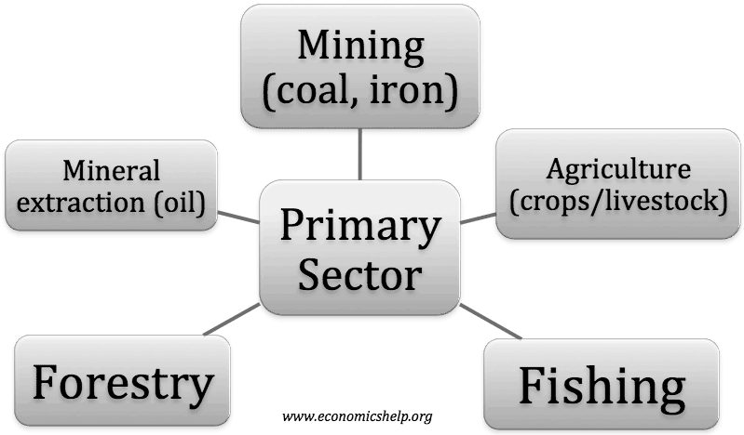
Why earning of occupation change over time
Table shows that workers in the agricultural, fishery and forestry industries
in 2012 earned the lowest wages in the UK with the exception of occupations in accommodation and food services, which generally offer unskilled work.
The main reason fur the low earnings in these industries;
is that the products produced, such as fish and food products, have a low sales value.
In general, as the value of a good or service increases, so does the wage of the person who produces it.

Slide 33
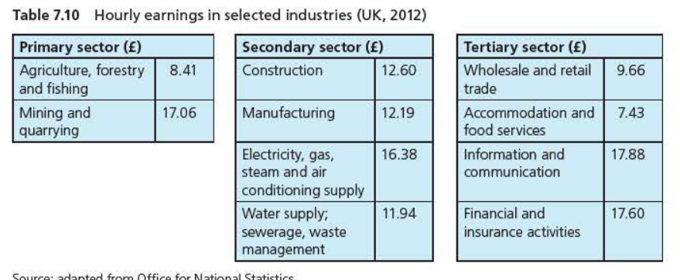
Why earning of occupation change over time
Differences in earnings between industrial sectors/stages of production

Slide 34
Table above also shows that occupations in the finance, insurance, information and communication industries typically earn the highest wages.
Tertiary sector occupations produce services of a higher value than those in the primary sector.
A rise in the price of minerals & metals explain high earnings of people working in mining and quarrying.
Skilled trades electricians & gas technicians in short supply in recent years in the UK,
partly due to the lengthy training period required (led to increased earnings)
People in tertiary sector professions tend to have high earnings because
To become a fully qualified accountant, doctor or lawyer requires postgraduate level study, professional examinations and many years of experience.
Reward for this time and effort is higher wages, which attract people to those professions.
Students take out loans for UNI and postgraduate training and they ·would only be prepared to do this because of the potential reward of high future
Activity in google classroom
Discuss the possible reasons why people who produce food, which is essential for life, get paid the lowest wages on Earth, while bankers, who produce nothing of substance , get paid the highest.

Slide 35
Changes in barging power
Change in union barging power can effect earning eg if governments lift ban on forming unions for certain sectors
Nurses unions more willing to strike for fairer pay
Nurses union strike: https://youtu.be/ub82Xb1C8os
Changes in Government policy
Expand public sector eg road building is decreased thus more workers available in private sector
Increasing Min wage rate
Improved education will ↑ skill level and ↑ workers productivity thus reduce costs and increase international competitiveness. ↑ demand of goods & service and MNC set up factories in country more need for workers
Policies on immigration – easier for foreigners to live & work will ↑ supply of labour this may ↓ wages
If the country needs certain occupations as well eg nurses
Anti-discrimination laws help disadvantage groups eg change attitude of women plus with increased education of women lead to higher wagers
Advances in technologies alter wages Down ward pressure by reducing demand for workers or may increase demand of of certain workers eg online shopping more drivers needed

Slide 36
Changes in earnings over a life-time
Earnings change over a person's lifetime for the following reasons
The level of education a person has tends to affect, in most cases, their earnings and earning potential
Inexperienced workers, such as graduates in their first year of work, earn less than experienced workers.
Salaries and wages usually increase with experience and time spent working at a firm.
After workers reach the peak of their career, their salaries and wages tend to remain fairly constant.
After retirement, earnings full and people are dependent on their pensions and savings to cover their living expenses.

Slide 37
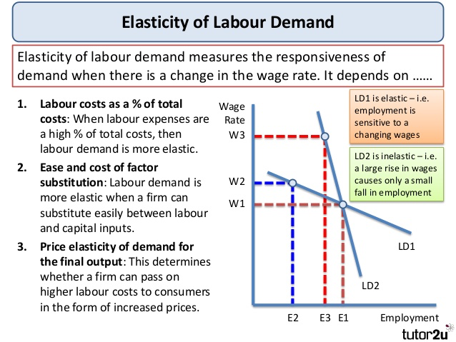
Elasticity of labour demand measures the responsiveness of demand when there is a change in the wage rate.

Slide 38
Elasticity of demand of labour
The elasticity of demand for labour depends on these factors:
Labour costs as a % of total costs:
When labour expenses are a high proportion of total costs, then labour demand is more elastic than a business where fixed costs of capital are the dominant business expense.
E.g. if labour costs only 10% of total costs easier to pass on to consumer (inelastic)
In many service jobs such as customer service centres or gas boiler repairs, labour costs are a high proportion of the total costs of a business.
The ease and cost of factor substitution:
Labour demand will be more elastic when a firm can substitute quickly and easily between labour and capital inputs.
When specialised labour or capital is needed, then the demand for labour will be more inelastic with respect to the wage rate.
E.G. it might be fairly easy and cheap to replace security guards with cameras but a hotel would find it almost impossible to replace hotel cleaning staff with machinery

Slide 39
The price elasticity of demand for the final output produced by a business:
If a firm is operating in a highly competitive market where final demand for the product is price elastic,
little market power to pass on higher wage costs to consumers through a higher price.
The demand for labour may therefore be more elastic as a consequence.
In contrast, a firm that sells a product where final demand is inelastic will be better placed to pass on higher costs to consumers.
Time;
Elasticity of demand likely to increase over time able to find substitute of labour.
Government legislation may make it hard let workers go in short periods of time

Slide 40
Some of the key factors affecting the wage elasticity of supply of labour are as follows:
Nature of skills and qualifications required to work in an industry
Specific skills and educational requirements make supply inelastic
Lengthy and costly training periods makes labour supply inelastic
When the minimum skill factor needed is relatively low, then the pool of available labour will be large, making labour supply elastic
Vocational nature of work - in vocational jobs such as nursing, people are less sensitive to changes in wages when deciding whether to work and how many hours to work
Time period –
In the short run, the supply curve for labour to a particular occupation tends to be relatively inelastic
It takes time for people to respond to changes in relative wages and earnings – especially if people need to be re-trained to enter a new occupation
When labour is geographically and occupationally mobile, then labour supply will tend to be relatively elastic even in the short term
Level of employment in the economy
Most workers already employed firms need to increase wages to attract workers from other occupations
Mobility of labour
Easy of finding jobs and move from one area to anther
Highly mobility supply of labour more elastic

Slide 41
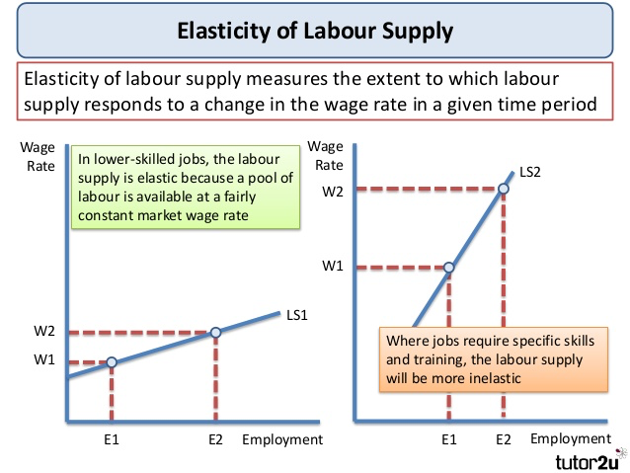

Slide 42
The supply of labor is generally said to be more elastic in lower-skilled jobs that require less training. For more skilled jobs, the supply of labor cannot change very quickly. For example, if the wages of doctors went up, there would be no great change in the number of doctors working because it takes a long time to get the training needed to be a doctor.

Slide 43
Specialisation occurs when workers are assigned specific tasks within a production process.
Workers will require less training to be an efficient worker.
Will lead to an increase in labour productivity and firms will be able to benefit from economies of scale (lower average costs with increased output) and increased efficiency.
Examples of specialisation and division of labour
In the process of producing cars, there will be a high degree of labour specialisation.
Some workers will design the cars
Some will work on testing cars
Some will work on marketing.
Some workers will work on different sections of the assembly line. Their job may be highly specific such as putting on tyres e.t.c.
Notes:
What is Specialisation?
Through years, production has developed into a complicated process and thus broken down into a series of highly specialised task. Each task is then performed by a worker. This is known as Division of Labour.

Slide 44

The division of labour occurs where production is broken down into many separate tasks.
The division of labour occurs where production is broken down into many separate tasks
Division of labour can raise output per person as people become proficient through constant repetition of a task
This is called “learning by doing”
This gain in labour productivity helps to lower the supply cost per unit
Reduced supply costs in theory will lead to lower prices for consumers of goods and services causing gains in economic welfare e.g. through an increase in consumer surplus

Slide 45
Advantages of Division of Labour
Practise makes perfect: Worker specialises in a particular task and gives in the best, thus producing goods faster and less wastage of material.
Use of machinery: Specialised machinery can be used which is further increase the productivity.
Increased Output: with improvement in efficiency and use of machinery output is increased.
Saves time: There is no time wasted in switching of jobs and thus the momentum of production can be maintained which leads to less wastage of time.
Skilled employees are more productive and are in greater demand.
Specialisation worker become skilled if in high demand can earn high wages (IA engineers)

Slide 46
Disadvantages of Division of Labour
Boredom: Performing the same task over and over again may lead to boredom for the workers.
Lack of variety: Though the number of goods produced increases but they are identical or standardized.
Low motivation for worker: Repeatedly performing the same task may lead to low motivation level for the worker. The worker might not have the sense of fulfilling a complete task as he is performing only a part of the job.
Lack of mobility: Due to specialisation workers might find it difficult to switch between occupations.
Skills and become redundant and outdated in line with economic growth and globalization.
Evaluation point
Division of labour benefits an economy depends on how it effects cost of production & quality of goods and serviced produced.
If it does result in lower costs of productions & higher quality of G&S it may be able to produce and export more G&S

Slide 47
Questions on page 161

Slide 50
Demand curve for labour
Number workers employed | MPP | Price= MR ($) | MRP= MPP x MR (p) | Wage rate per week
1 | 20 | 10 | 200 | 160
2 | 18 | 10 | 180 | 160
3 | 16 | 10 | 160 | 160
4 | 14 | 10 | 140 | 160
5 | 12 | 10 | 120 | 160
6 | 10 | 10 | 100 | 160
160
140
120
MRP & Wage rate
MRP
0 3 4 5
$10 per unit MRP to be figured out
All out put sold at same price thus same slope as the MPP curve
Current wage rate $160
Profit maximising employ workers up to W = MRP
Q of labour employed
Wages $160 3 workers employed W=MRP 4 worker less MRP
Wages 🡻 $140 4 worker will be employed
At $120 5 worker employed W= MRP
Thus firms demand curve for labour is the MRP Curve

Slide 51
The labour Market
The labour Market
However, the supply curve is
not continuously upward slopingIt is in fact, backward bending as wages increase.
Wage Rate
The Backward Bending Supply curve.
Wage Rate
S
W1
S
W0
W0
D
D
Units of Labour/hour
Units of Labour/hour
10hrs
20hrs
As wages decrease, the demand for labour by the firms will increase. (see demand curve).
As wages decrease, the supply of labour by the
consumers will decrease. (see demand curve).
As wages increase, labour would work less hours. With higher wages, they could work less hours and still make the same total salary as one who is paid lower but work more hours.
With the time saved, they can have more recreation.

Slide 52
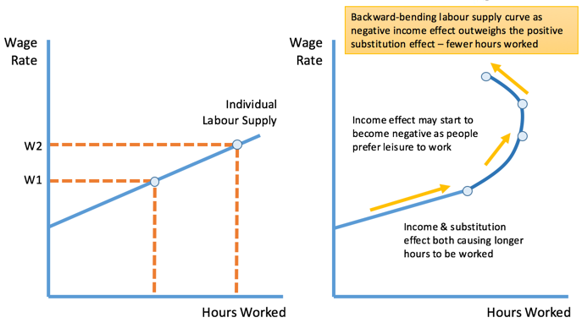

Slide 53


Factor substitution

Slide 54
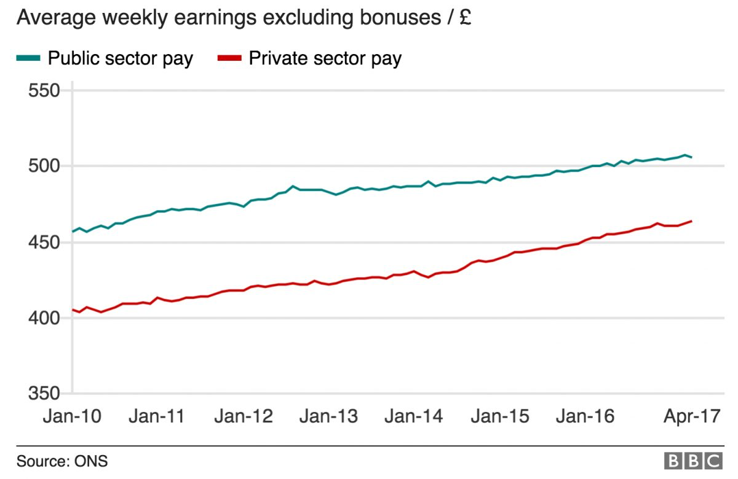

Slide 55
In theory, private sector can earn more than in the public sector.
In many countries, salaries in public sector less than private sector,
public-sector jobs more secure and pension in retirement.
public-sector jobs are teachers, nurses, police officers, fire service officers and civil servants.
Private-sector jobs typically have higher earning potential as private individuals and firms (profit maximisation)
For example, Lloyd Blankfein, CEO Goldman Sachs Group,75% pay rise in 2012 and earned $21 million.
More risk as jobs are less secure in the private sector and workers often have to save up fur their own pensions in retirement.
For example, the global financial crisis in late 2008 had caused over 11000 job losses at Citibank Group by the end of 2013.
US investment bank JPMorgan Chase cut 19000 jobs during the same period.

Slide 56

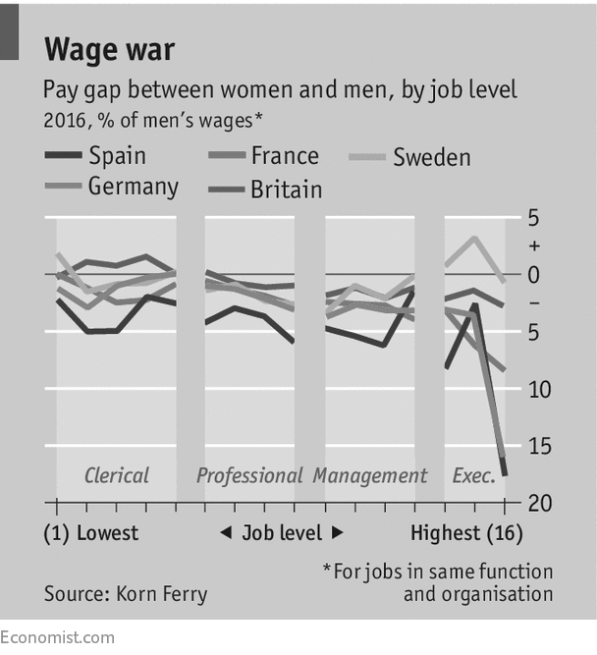
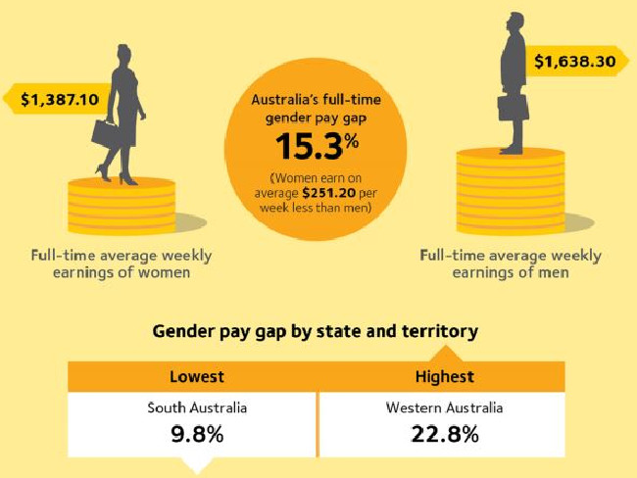

Slide 57
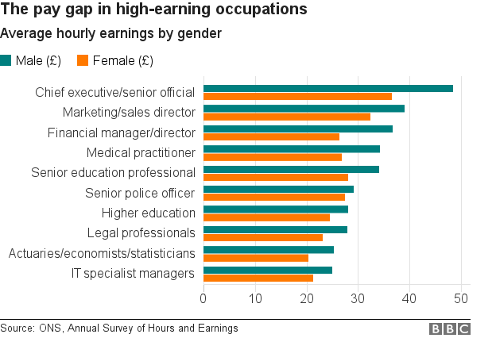
https://www.economist.com/news/international/21729993-women-still-earn-lot-less-men-despite-decades-equal-pay-laws-why-gender

Slide 58


Slide 59
This pattern occurs throughout the world. Possible reasons for the difference in male and female earnings include the following:
• There are more women in part-time work than men, so their earnings are lower on average.
• Women take career breaks to have children and therefore miss out on promotional opportunities.
• Women may accept low-paid and part-time jobs, as hours are flexible and can fit in with childcare arrangements.
• Women may face discrimination at work.
However, times are changing for females, especially those in more economically developed countries such as the UK:
• In the UK's Financial Time Stock Exchange (FTSE) 1OO firms, 17.3 per cent had female directors in April 2013 - an increase from 12.5 per cent in 2011.
• There are more females than males in the UK enrolled on veterinary science courses and in subjects associated with medicine at university.
• More than half of the head teachers in the UK are now females.

Slide 60
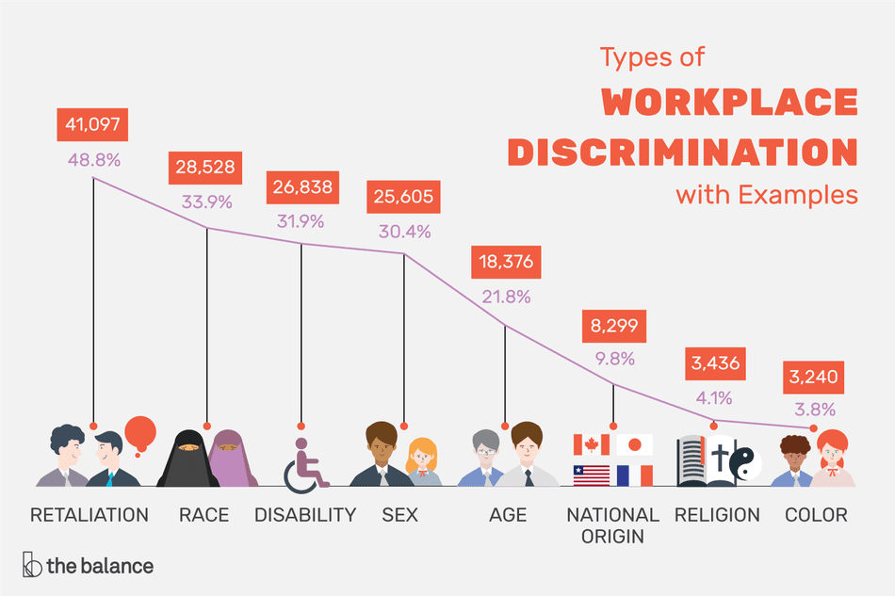
The valuation in the market-place of personal characteristics of the worker that are unrelated to worker productivity.
Age
Gender
Race
Ethnicity
Skin Color
National Origin
Mental or Physical Disability
Genetic Information Relationship to someone who may be discriminated against
Pregnancy or Parenthood
Notes:
Stating or suggesting preferred candidates in a job advertisement
Excluding potential employees during recruitment
Denying certain employees compensation or benefits
Paying equally-qualified employees in the same position different salaries
Discriminating when assigning disability leave, maternity leave, or retirement options

Slide 61
The market can fail to end discrimination if:
Government legislation enforces discrimination (apartheid laws US, South Africa)
Discrimination – pre-labour market.
One major cause of wage differentials is not discrimination by employers but different life chances and education of people entering the labour market.
If black-Americans have fewer qualifications than average, economic theory would predict that even with non-discriminatory employers, average wages would be lower for certain groups.

Slide 62


Slide 63
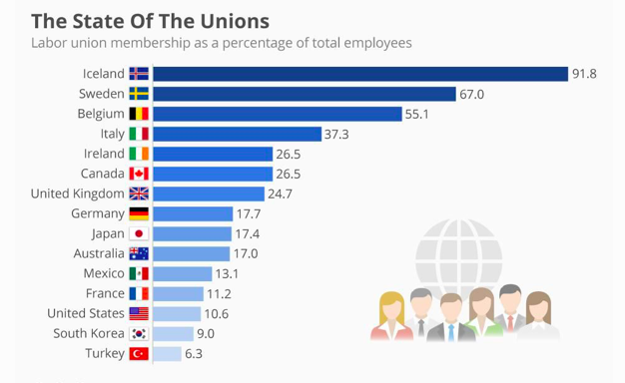
The four major union confederations are All Indonesian Workers Union Confederation (KSPSI) Reconciliation, KSPSI Jakarta Congress, Confederation of Indonesian Prosperity Labour Union (KSBSI) and Indonesian Trade Union Confederation (KSPI).

